Slide 1
Programming Fundamentals Lecture #3 Overview of Computer Programming
Junaid Hassan
Lecturer CS & IT Department UOS MBDIN
junaidte14@gmail.com

Slide 2
Assignment
What do you know about history of C Programming Language?
Consult course book (C How to Program by Paul Dietel and Harvey Dietel, 6th or 7th Edition)
Do some research on internet
Discuss your concepts with your classmates
Submit your assignment in hand written pages
There may be a viva from your submitted assignment, so avoid copying other’s assignment

Slide 3
C Standard Library
C programs consist of modules / pieces called as functions
C standard library is a library having pre-built functions.
So if there’s an already built-in function available in C standard library then programmers prefer to use those functions instead of creationg their own functions.
This approcah of using already available functions is called software reuseability approach

Slide 4
C Programming Building Blocks
When programming in C use following building blocks:
C standard library functions (or Library Functions)
Functions you create yourself (or Custom Functions)
Functions other people have created and made available to you

Slide 5
Functions you create yourself (Custom Functions)
Advantages:
you know your code exactly how it works
You can examin that code easily
Disadvantages:
Time consuming process
Reinventing the wheel
Performance issues
Security issues
Compatibility issues

Slide 6
C Standard Library Functions (Library Functions)
Advantages:
No security issues
No performance issues
No compatibility issues
Your code will be portable to all devices which uses standard C implementations
Code will be error free
Time is saved
Disadvantages:
You will have to learn how to use that function

Slide 7
Typical C Program Development Environment
C systems consist of 3 main parts:
Program development environment
C programming language
C standard library
C Program Development Environment means which phases are involved in a typical C Program Development.

Slide 8
Typical C Program Development Environment
C program typically goes through six phases:
Phase 1: Creating a program (editor programs are used to create code files. These code files are stored in our computer hard drive. C program files are ended with the extension .c)
Phase 2: Preprocessing (certain manipulations are performed befor compilation e.g inclusion of external files in the main program file)
Phase 3: Compiling a C program (compiler translates C program/code to machine-language code. machine-language code also called as object code)
Phase 4: Linking (Linker links the object code with the libraries, creates an executable file and stores it on disk)
Phase 5: Loading (Loader puts the program in memory)
Phase 6: Execution (CPU takes each instruction and executes it)

Slide 9
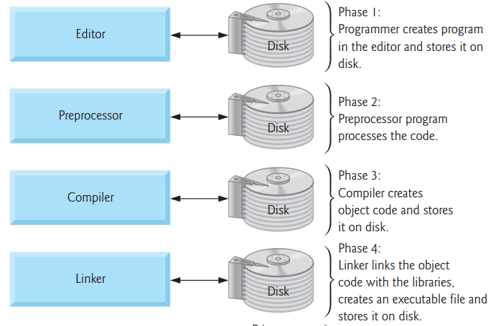
Typical C Program Development Environment
C program typically goes through six phases:

Slide 10
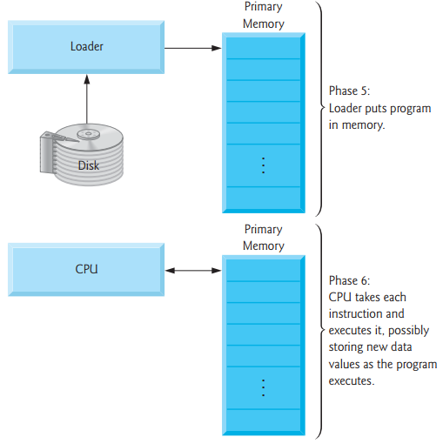
Typical C Program Development Environment
C program typically goes through six phases:

Slide 11
Typical C Program Development Environment
Problems that may occure at execution time:
Code Errors (in case of errors we go back to the editor phase, fix that error and then execute the program again)
Two type of errors can occure in a program:
Fatal Errors (which causes the program to terminate immediately without proceeding further e.g division by zero). Fatal errors are also called as run time errors or execution time errors.
None Fatal Errors (These errors allow programs to execute completely but produces incorrect results)

Slide 12
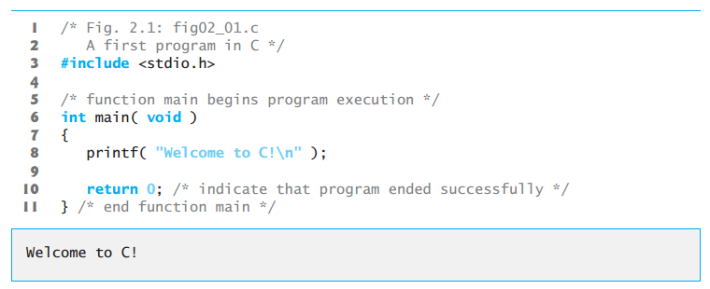
A Simple C Program
Prints a line of text:

Slide 13
A Simple C Program
Lines starting with /* and ending with */ are called comments (multi line comments)
Comments are used to describe why we added this code line thus improving program readability
Comments are not executed when we run our program
Comments are ignored by compilers
Comments help other people to understand your program
Lines starting with // are also called comments (single line comment)
We don’t need to end single line comments
Lines starting with # are processed by preprocessor before the program is compiled
e.g #include <stdio.h> tells the preprocessor to include standard input output header file in our program
Why? Because we want to use functions available in that standard library.
In our program we used a function printf() which is actually defined stdio.h standard library file.

Slide 14
A Simple C Program
int main(void){ ..... } is part of every C programs.
Parentheses show that it’s a function.
A function is building block which takes an input, processes that input and return an output.
This main function is executed at first. Every C program must have atleast one main function.
Int means that this function return an integer value.
void means that this function does not accept any input
{ left brace starts the body of the function where } right brace ends the body of the function
printf(“”Welcome to C!\n”); instructs the computer to perform an action i.e to print on the screen the string of characters inside quotation marks and \n says that after printing that string move to the next line
This entire line printf(“”Welcome to C!\n”); is called a statement.

Slide 15
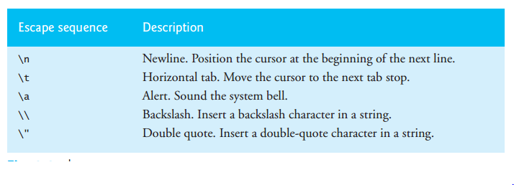
A Simple C Program
Every statement must end with a semicolon (also called as statement terminator)
The backslash (\) is called an escape character. Every escape character when combined with character after it, form an escape sequesnce.
Every escape sequence has a special meaning e.g \n when appears inside a string output by printf means newline. It moves the cursor position to the next line

Slide 16
A Simple C Program
return 0; is included at the end of each main function
Keyword return is used to exit a function

